Slide 1
INTRODUCTION TO
ALGORITHMS
FOURTH EDITION

Slide 2
LECTURE NOTES FOR CHAPTER 11
Hash Tables

Slide 3
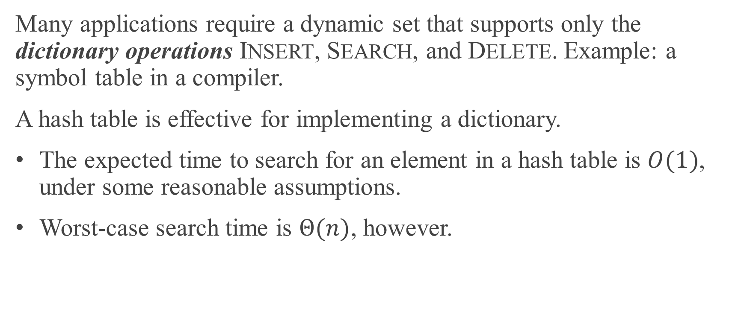
CHAPTER 11 OVERVIEW
Many applications require a dynamic set that supports only the dictionary operations INSERT, SEARCH, and DELETE. Example: a symbol table in a compiler.
A hash table is effective for implementing a dictionary.
The expected time to search for an element in a hash table is $O(1)$, under some reasonable assumptions.
Worst-case search time is $Θ(n)$, however.

Slide 4
CHAPTER 11 OVERVIEW (continued)
A hash table is a generalization of an ordinary array.
With an ordinary array, store the element whose key is k in position k of the array.
Given a key k, to find the element whose key is k, just look in the kth position of the array. This is called direct addressing.
Direct addressing is applicable when you can afford to allocate an array with one position for every possible key.

Slide 5
CHAPTER 11 OVERVIEW (continued)
Use a hash table when do not want to (or cannot) allocate an array with one position per possible key.
Use a hash table when the number of keys actually stored is small relative to the number of possible keys.
A hash table is an array, but it typically uses a size proportional to the number of keys to be stored (rather than the number of possible keys).
Given a key k, don’t just use k as the index into the array.
Instead, compute a function of k, and use that value to index into the array. We call this function a hash function.

Slide 6
CHAPTER 11 OVERVIEW (continued)
Issues that we’ll explore in hash tables:
How to compute hash functions. We’ll look at several approaches.
What to do when the hash function maps multiple keys to the same table entry. We’ll look at chaining and open addressing.

Slide 7
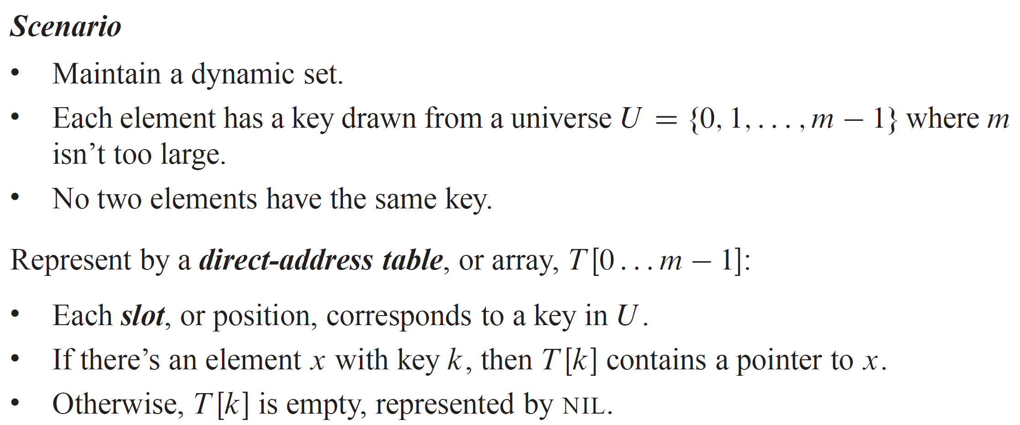
DIRECT-ADDRESS TABLES

Slide 8
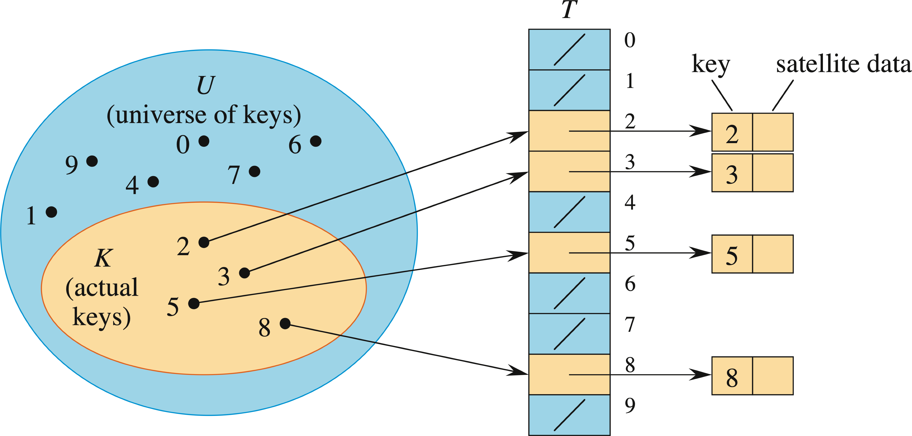
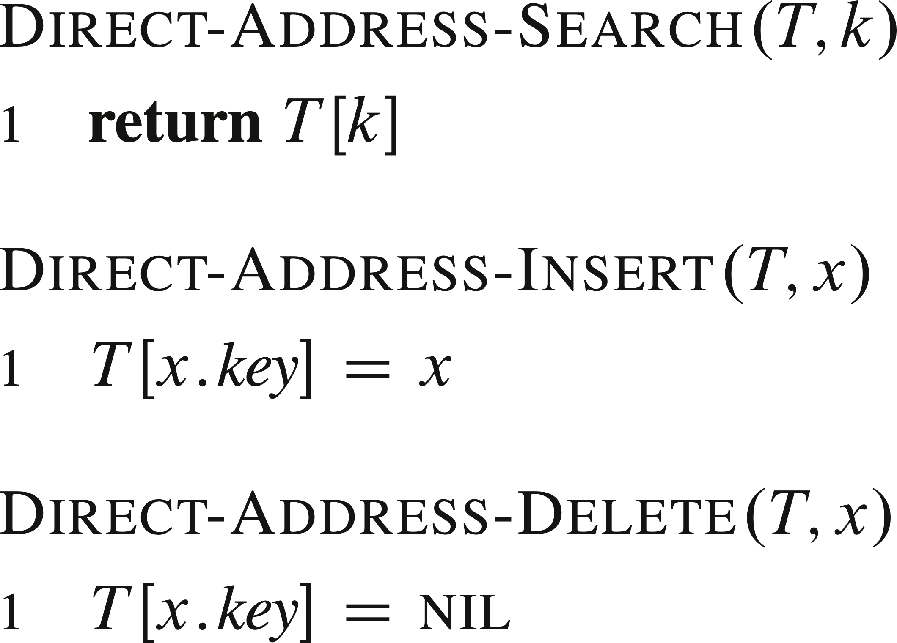
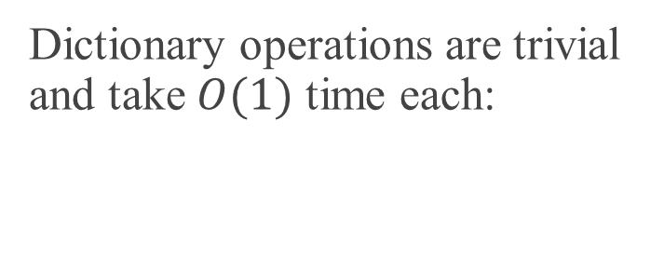
DIRECT-ADDRESS TABLES (continued)
Dictionary operations are trivial and take $O(1)$ time each:

Slide 9
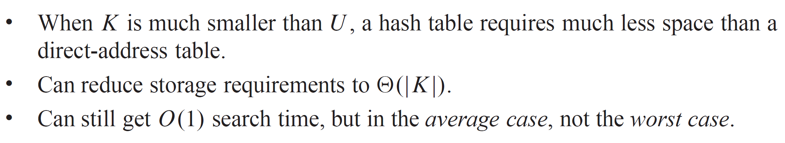
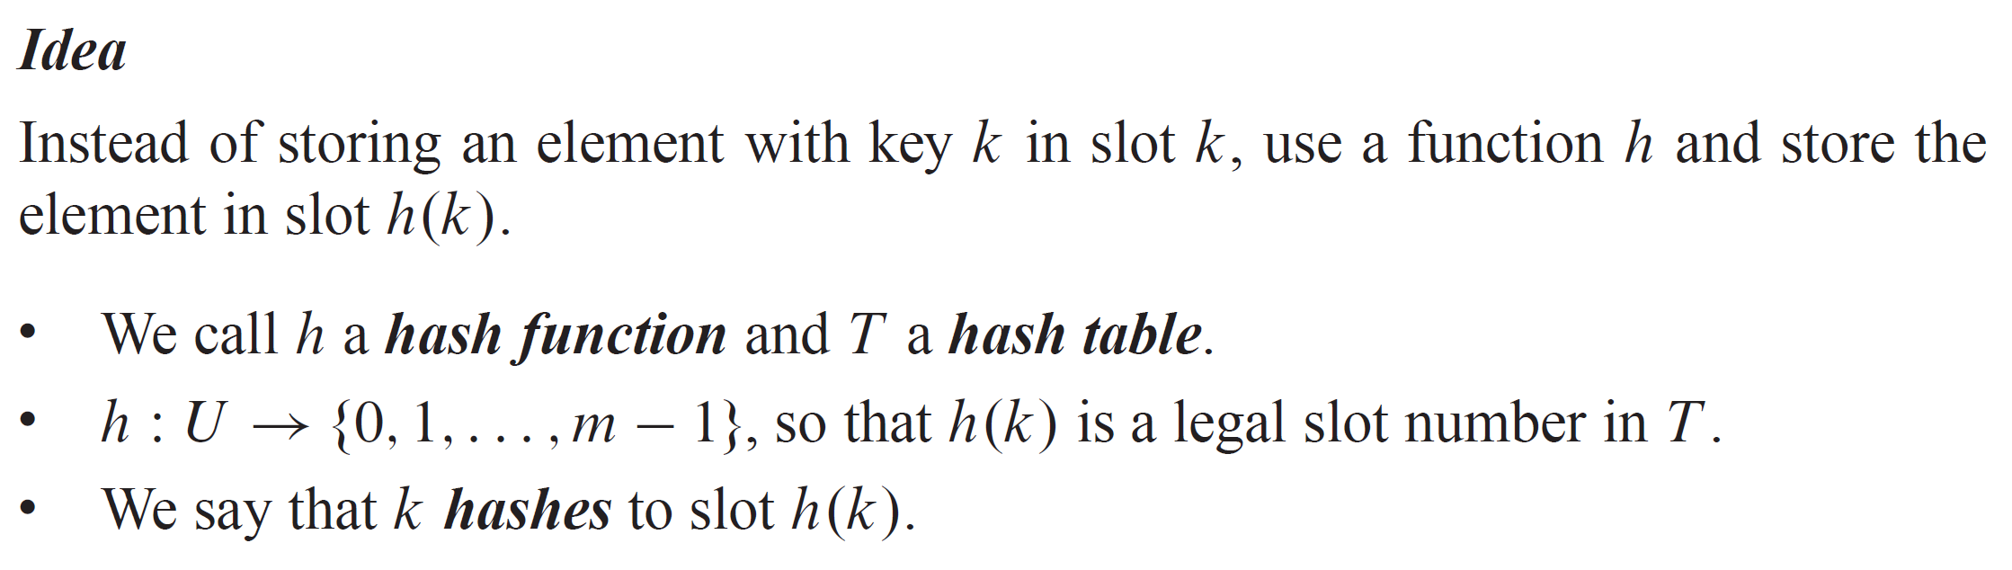
HASH TABLES

Slide 10
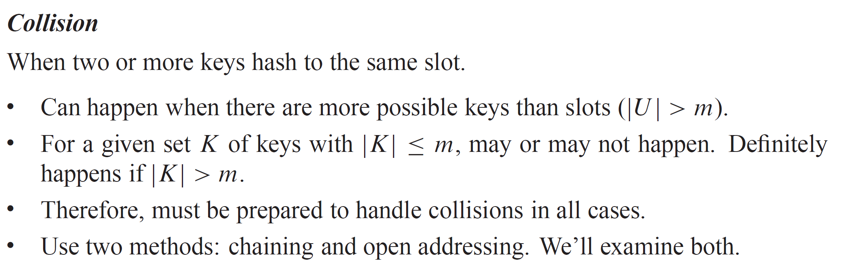
HASH TABLES (continued)

Slide 11
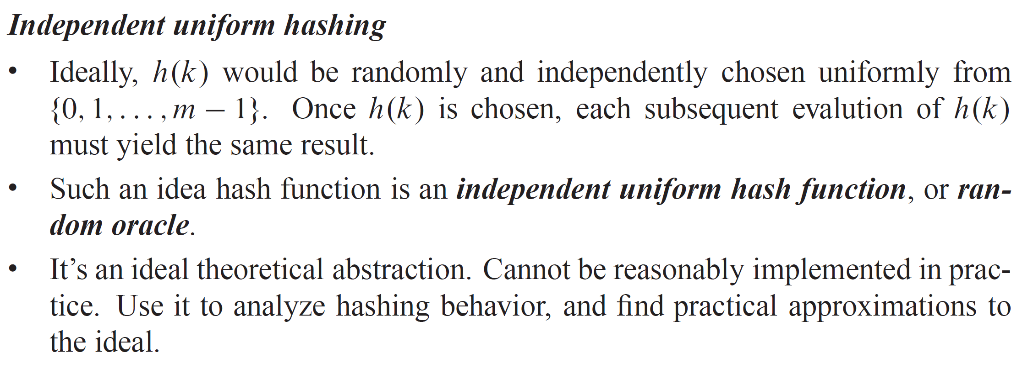
HASH TABLES (continued)

Slide 12
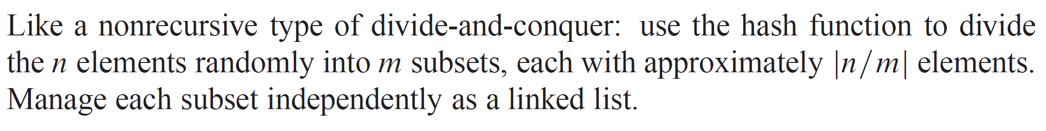
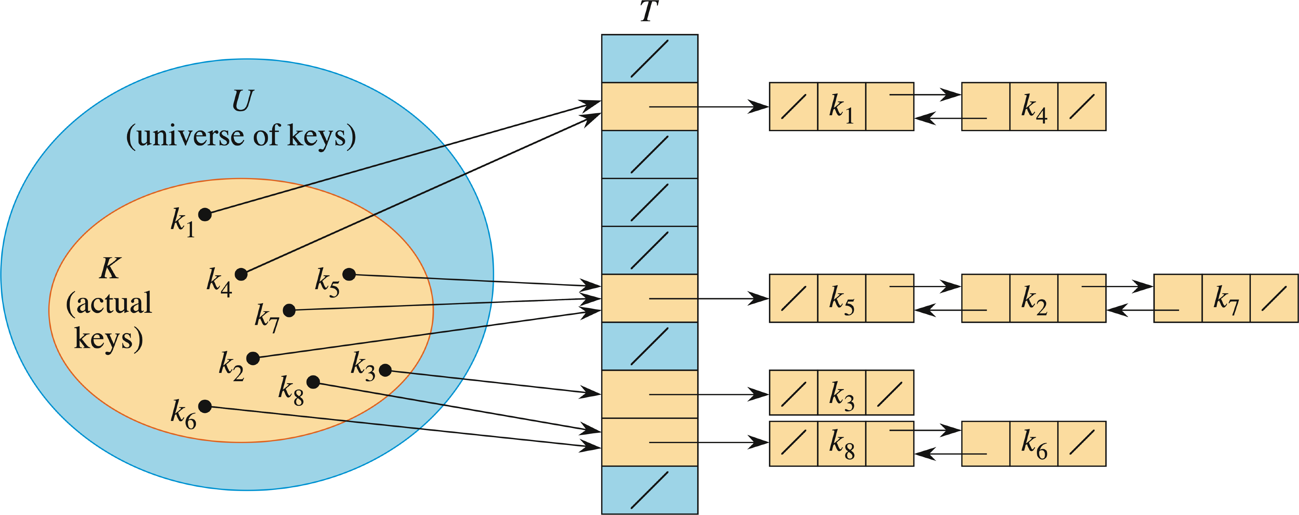
COLLISION RESOLUTION BY CHAINING
This figure shows singly linked lists. If needed to delete elements, it’s better to use doubly linked lists.

Slide 13
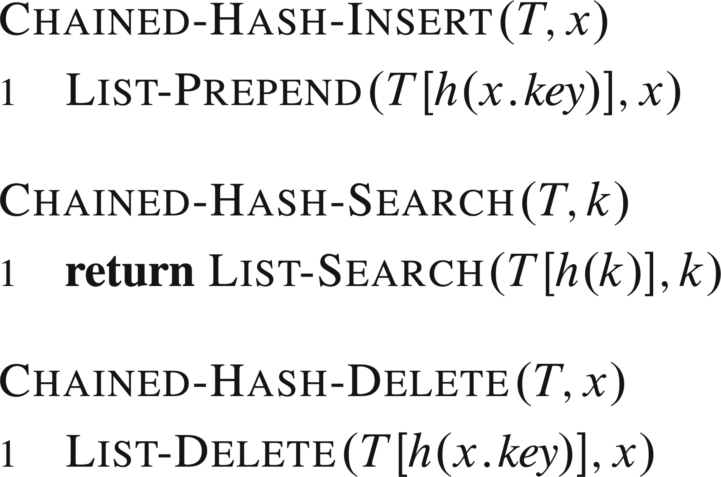
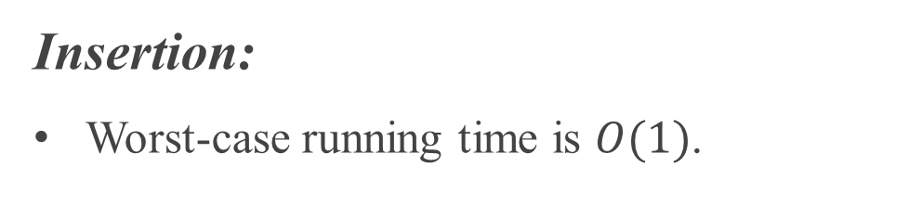
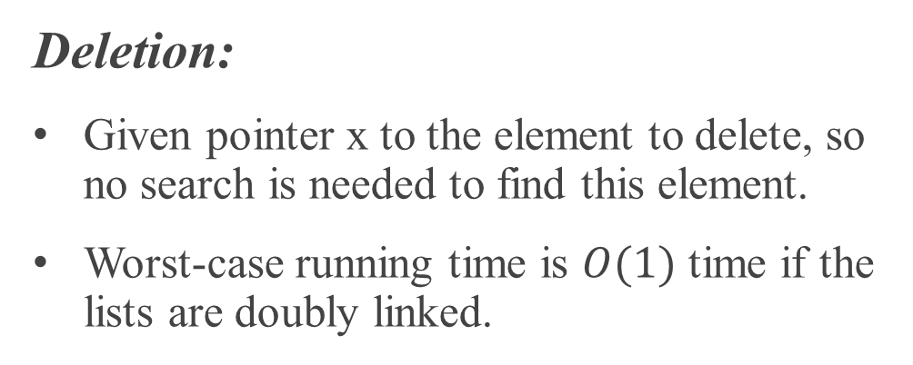
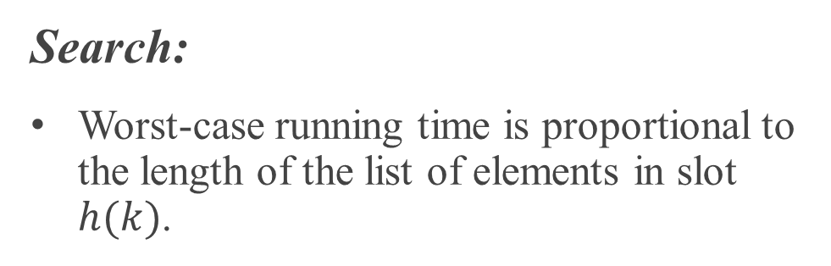
COLLISION RESOLUTION BY CHAINING (continued)
Insertion:
Worst-case running time is $O(1)$.
Search:
Worst-case running time is proportional to the length of the list of elements in slot $h(k)$.
Deletion:
Given pointer x to the element to delete, so no search is needed to find this element.
Worst-case running time is $O(1)$ time if the lists are doubly linked.

Slide 14
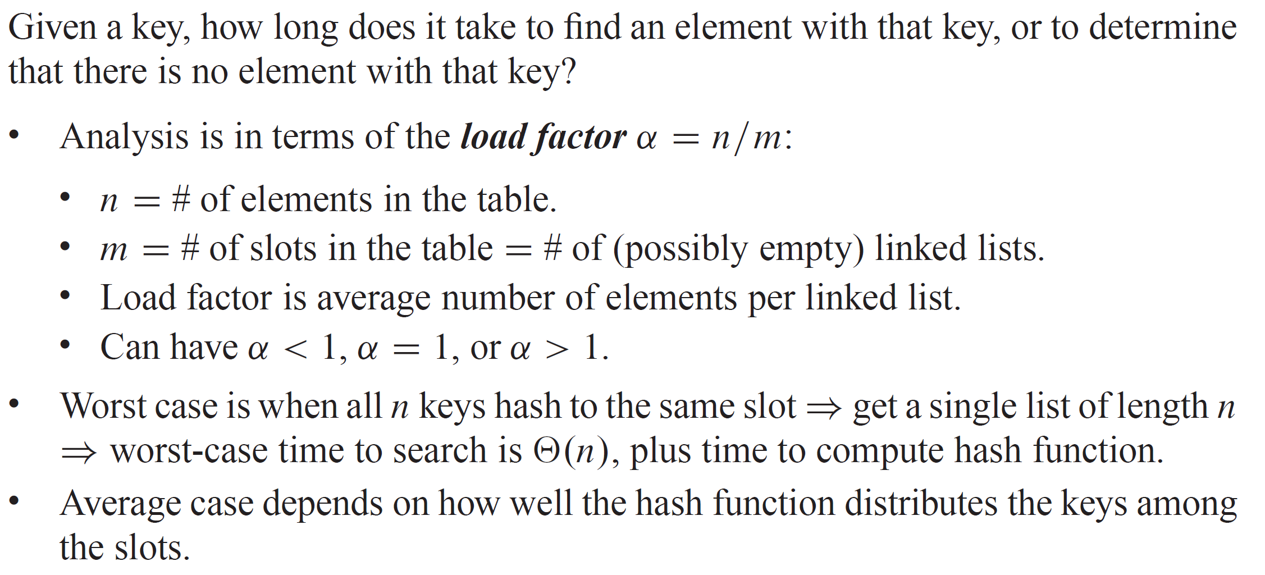
ANALYSIS OF HASHING WITH CHAINING

Slide 15
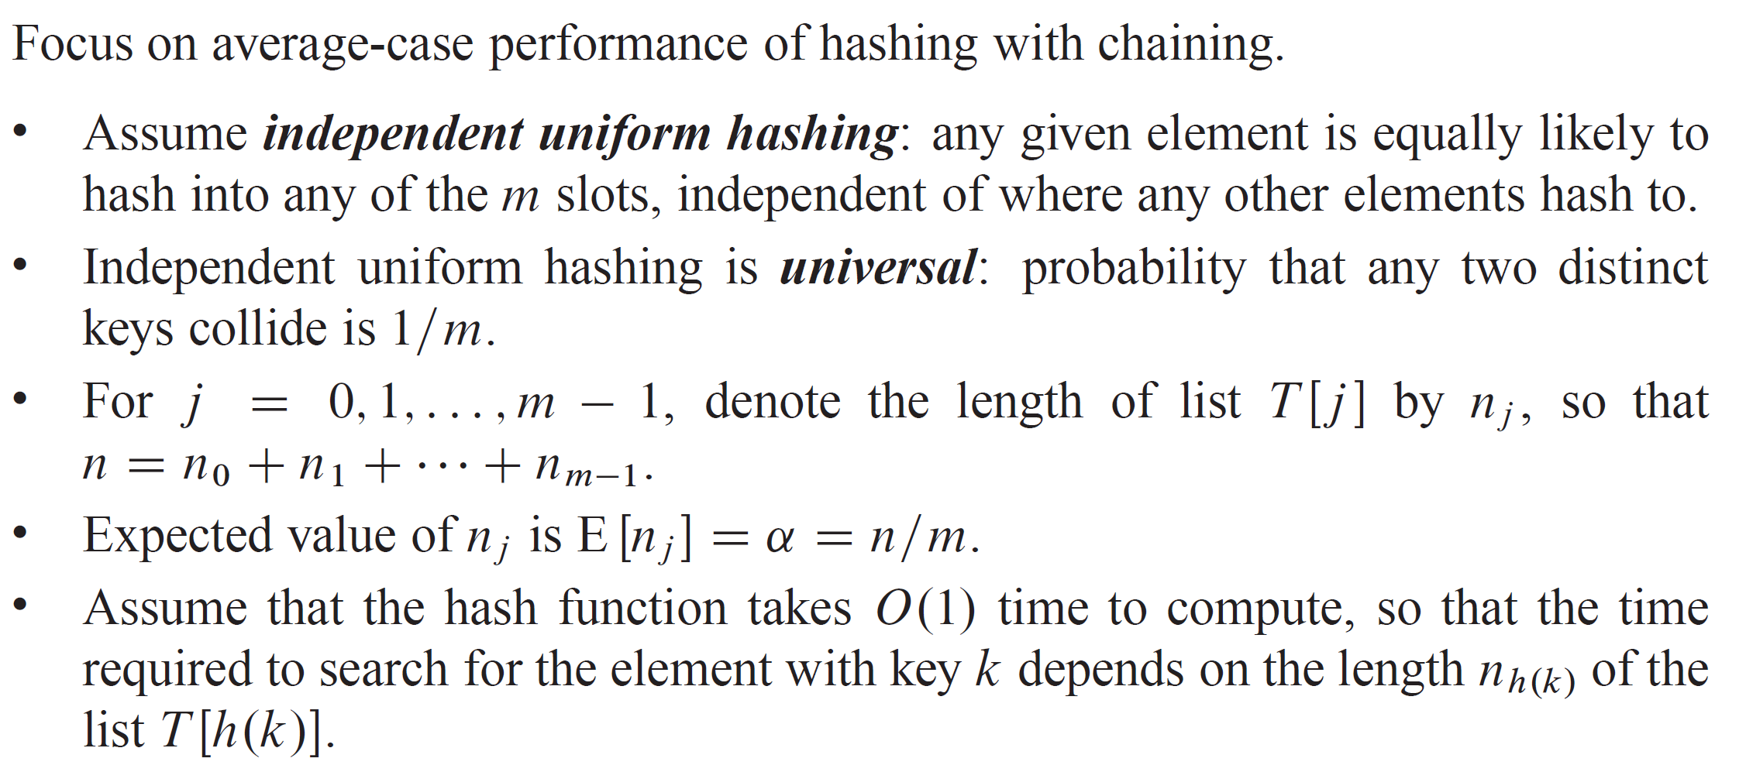
ANALYSIS OF HASHING WITH CHAINING (continued)

Slide 16
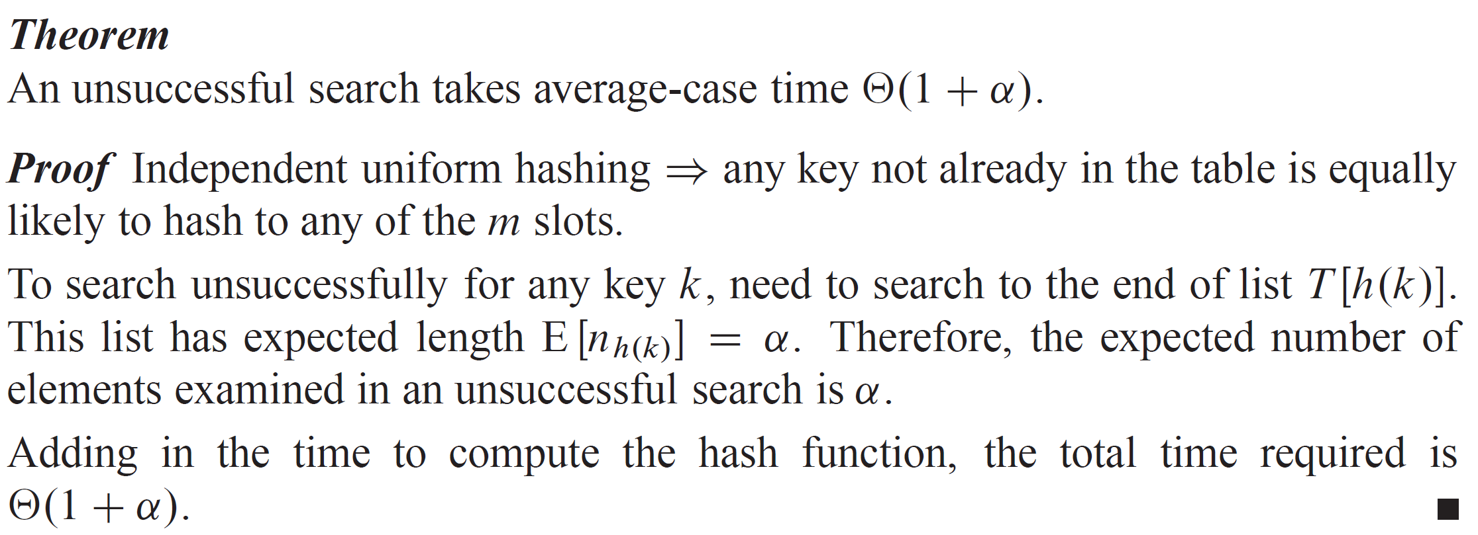
UNSUCCESSFUL SEARCH

Slide 17
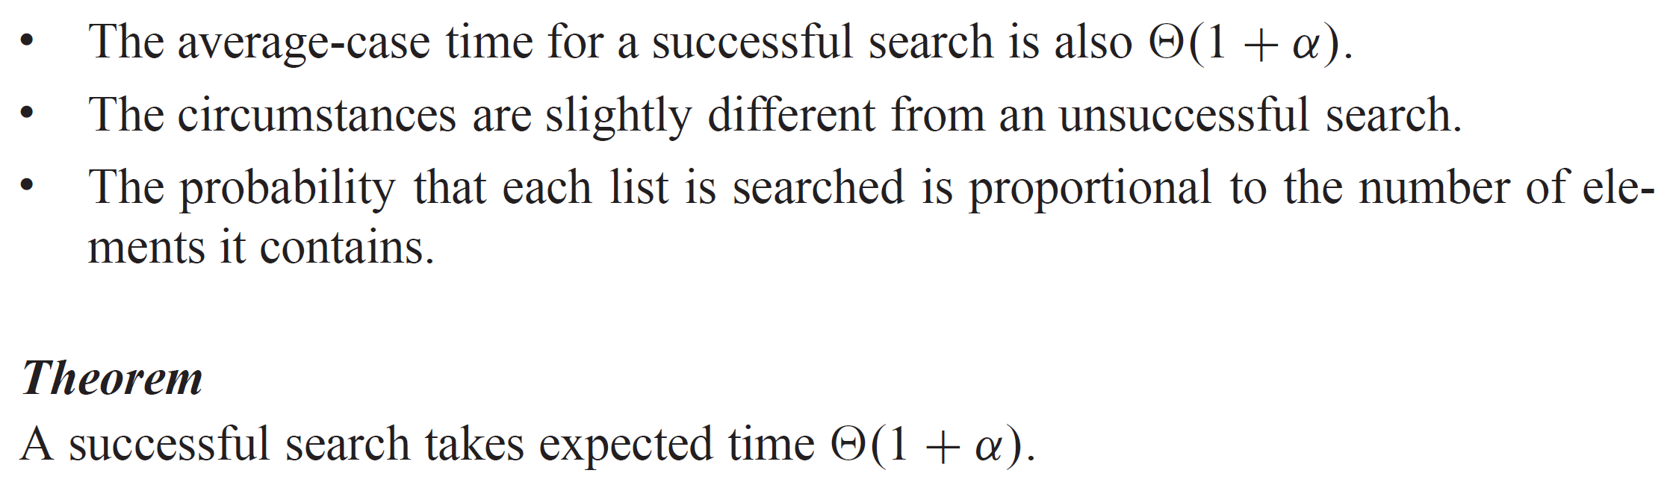
SUCCESSFUL SEARCH

Slide 18
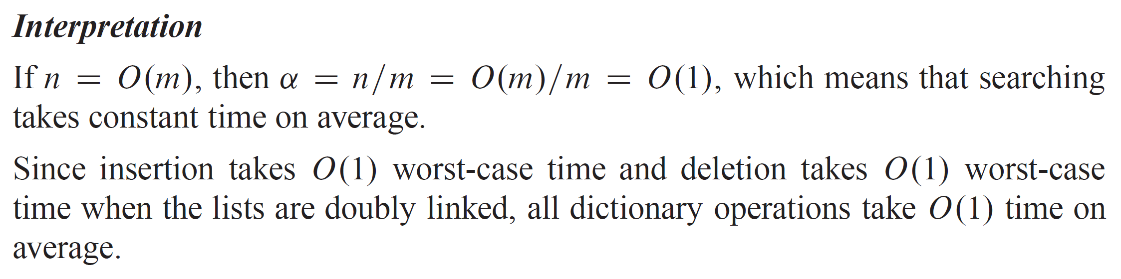
SEARCH ANALYSIS
Intuition
A successful search is like an unsuccessful one, except we get to stop looking in the list once we find the actual item. Subtleties related to the order of item insertion, and the fact that the list being searched will have at least this one element, are fully addressed in the textbook.

Slide 19
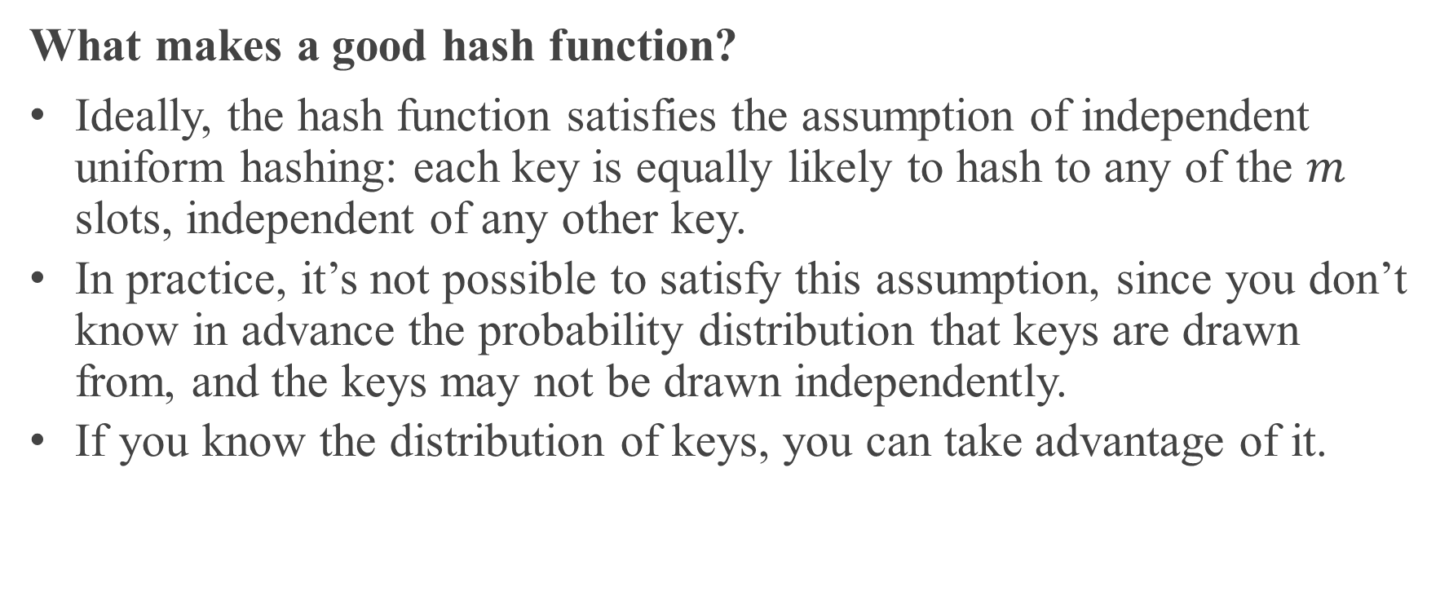
HASH FUNCTIONS
What makes a good hash function?
Ideally, the hash function satisfies the assumption of independent uniform hashing: each key is equally likely to hash to any of the $m$ slots, independent of any other key.
In practice, it’s not possible to satisfy this assumption, since you don’t know in advance the probability distribution that keys are drawn from, and the keys may not be drawn independently.
If you know the distribution of keys, you can take advantage of it.

Slide 20
KEYS ARE INTEGERS, VECTORS, OR STRINGS
In practice, hash functions assume that the keys are either
A short nonnegative integer that fits in a machine word (typically 32 or 64 bits), or
A short vector of nonnegative integers, each of bounded size, e.g., a string of bytes.
For now, assume that keys are short nonnegative integers.

Slide 21
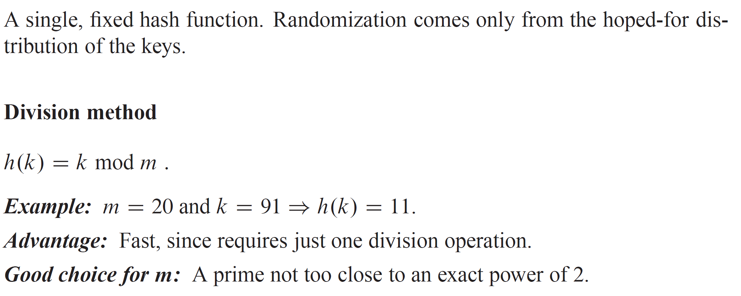
STATIC HASHING

Slide 22
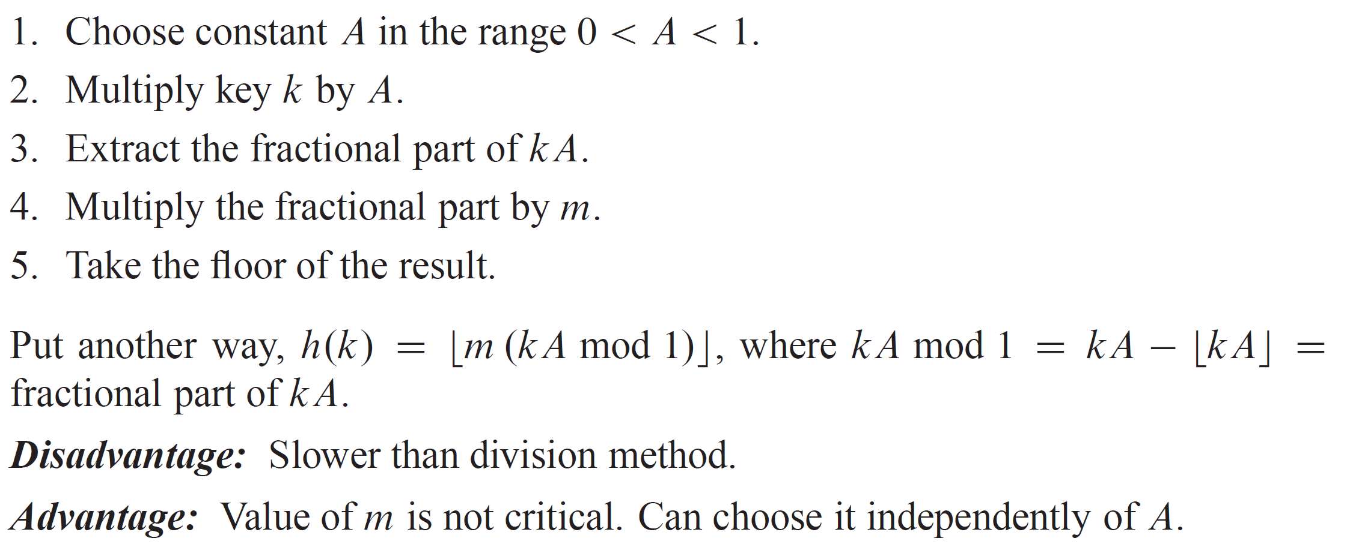
MULTIPLICATION METHOD
The multiply-shift method is a fast special case of the multiplication method. It is covered in the textbook.

Slide 23
RANDOM HASHING
Suppose that a malicious adversary, who gets to choose the keys to be hashed, has seen your hashing program and knows the hash function in advance. Then they could choose keys that all hash to the same slot, giving worst-case behavior. Any static hash function is vulnerable to this type of attack.
One way to defeat the adversary is to choose a hash function randomly independent of the keys. We describe a special case, universal hashing, which can yield provably good performance average when collisions are resolved by chaining, no matter the keys.

Slide 24
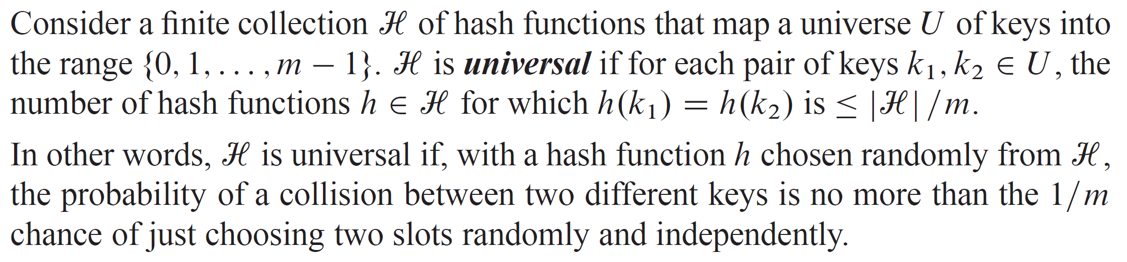
RANDOM HASHING (continued)

Slide 25
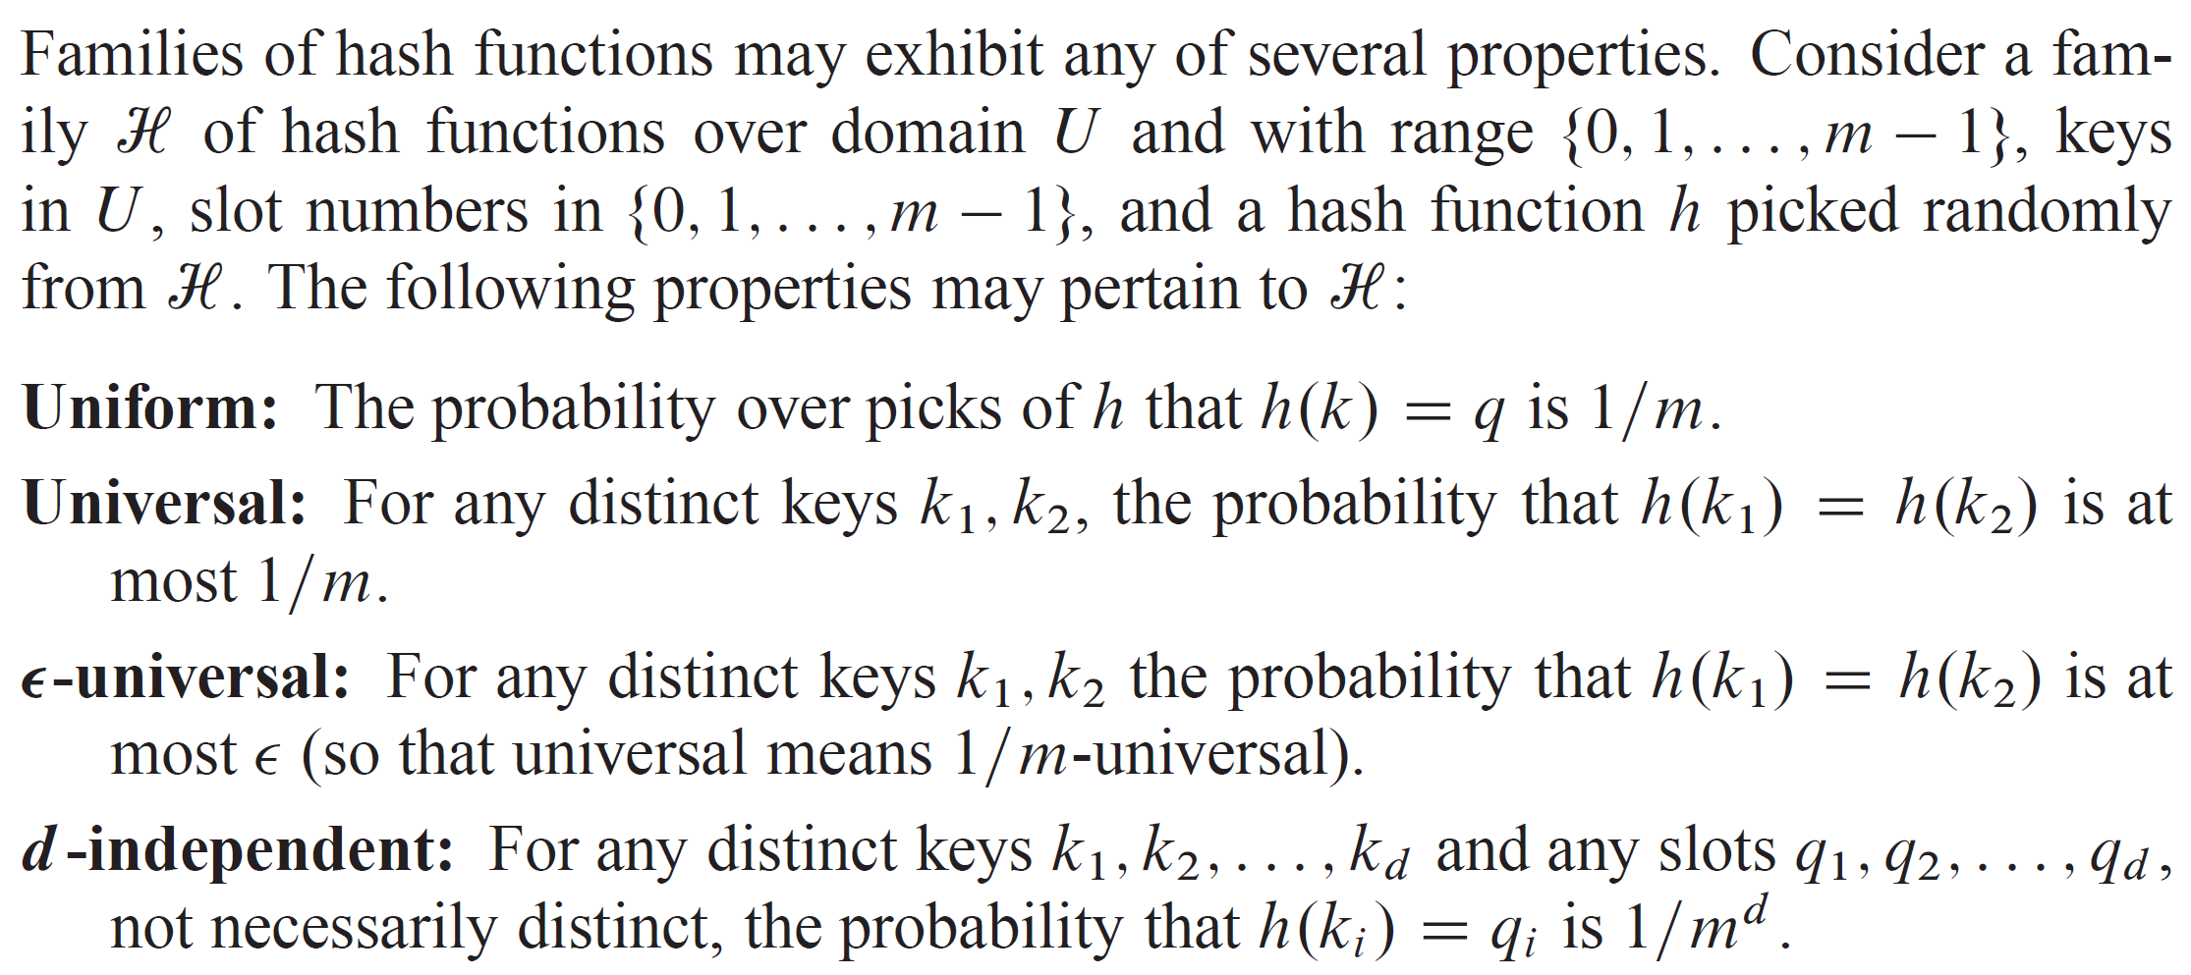
ACHIEVABLE PROPERTIES OF RANDOM HASHING

Slide 26
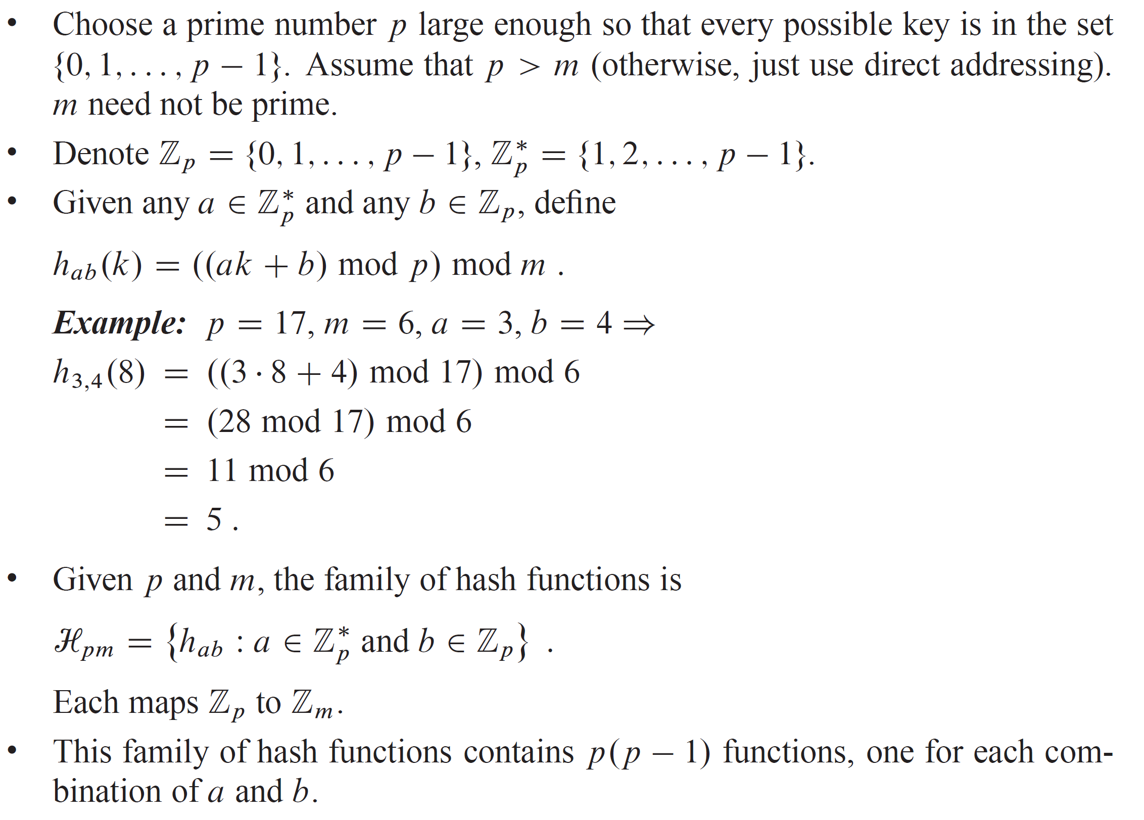
BASED ON NUMBER THEORY

Slide 27
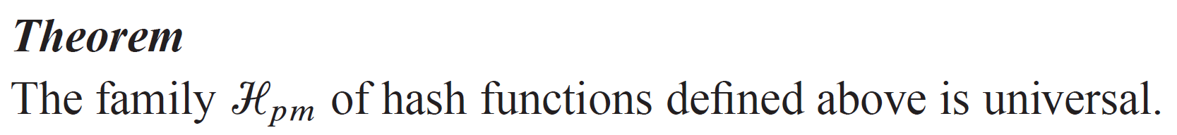
BASED ON NUMBER THEORY (continued)
Notes:
The proof is in the textbook.
Another practical method based on multiply-shift is discussed there as well. It is very efficient in practice.

Slide 28
OPEN ADDRESSING
Idea
Store all elements in the hash table itself.
Each slot contains either an element or NIL.
The hash table can fill up, but the load factor can never be > 1.
How to handle collisions during insertion:
Determine the element’s “first-choice” location in the hash table.
If the first-choice location is unoccupied, put the element there.
Otherwise, determine the element’s “second-choice” location. If unoccupied, put the element there.
Otherwise, try the “third-choice” location. And so on, until an unoccupied location is found.
Different elements have different preference orders.

Slide 29
OPEN ADDRESSING (continued)
How to search:
Same idea as for insertion.
But upon finding an unoccupied slot in the hash table, conclude that the element being searched for is not present.
Open addressing avoids the pointers needed for chaining. You can use the extra space to make the hash table larger.

Slide 30
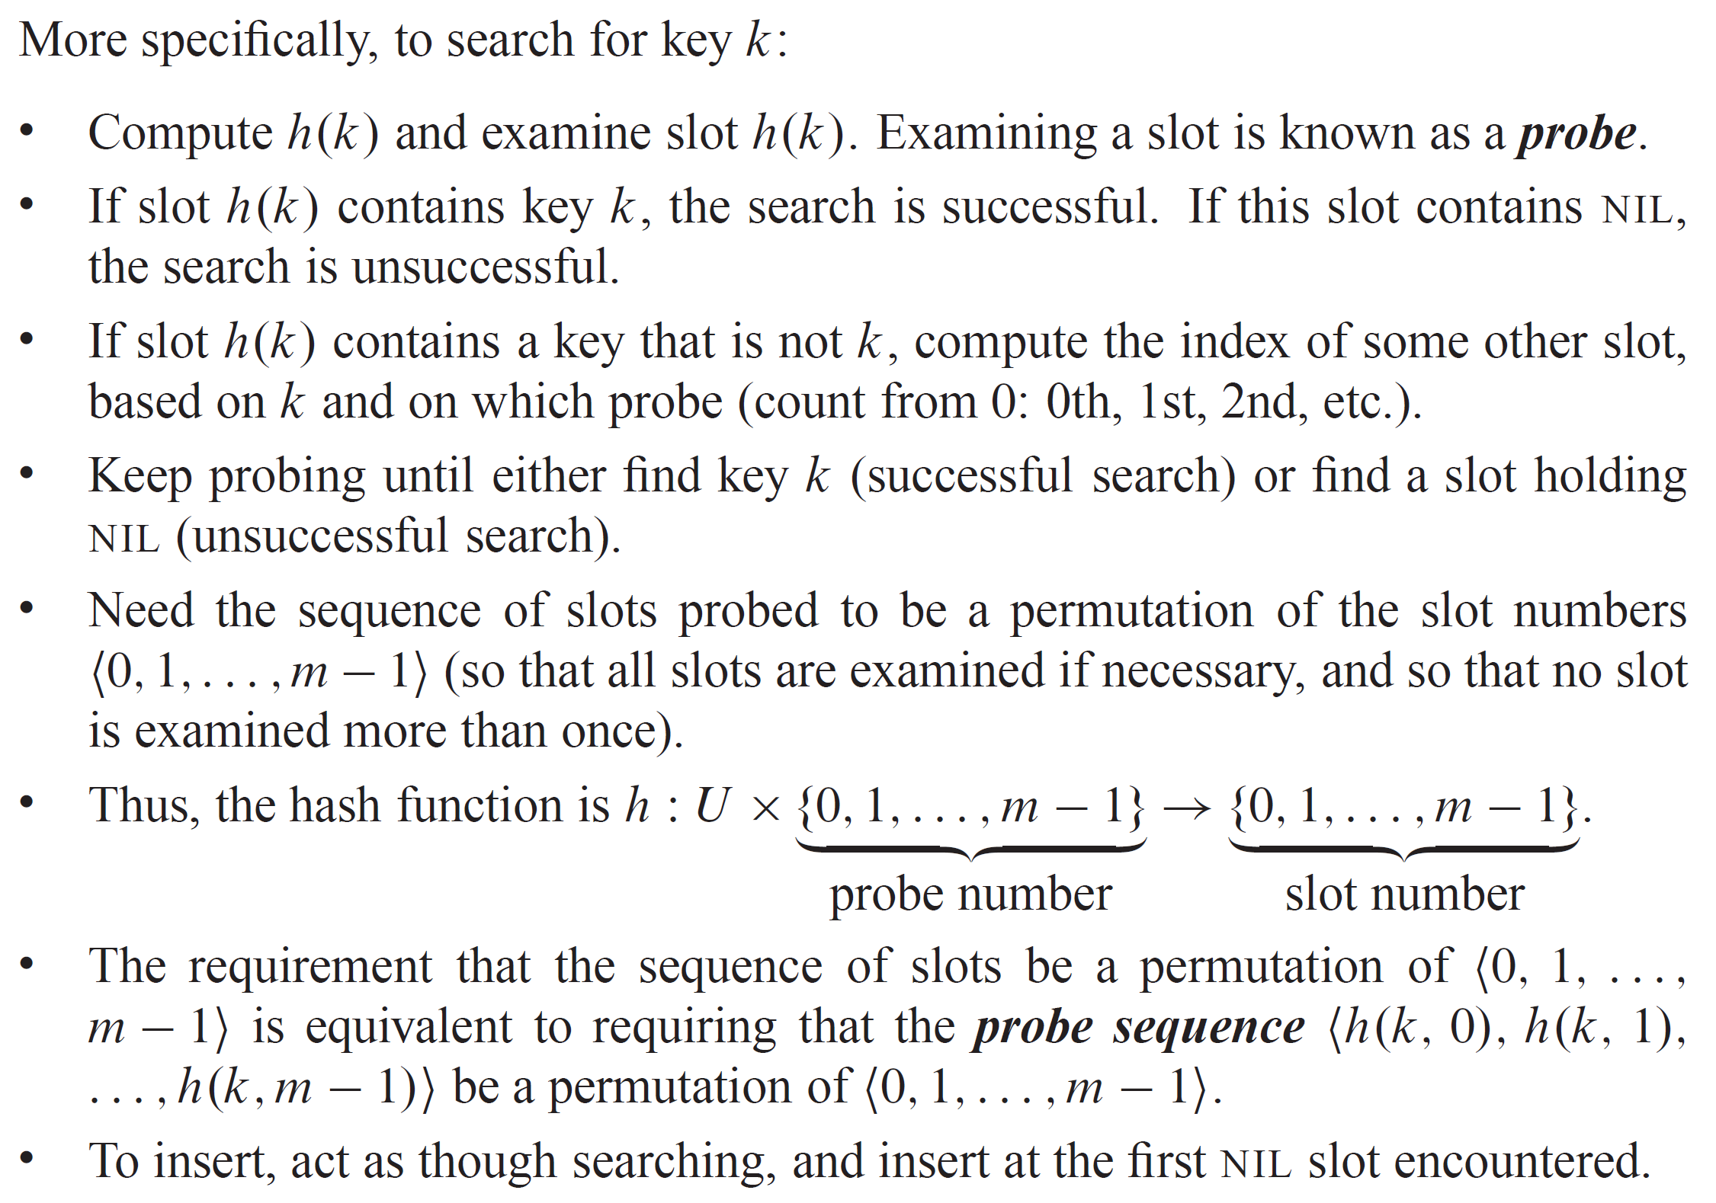
OPEN ADDRESSING (continued)

Slide 31
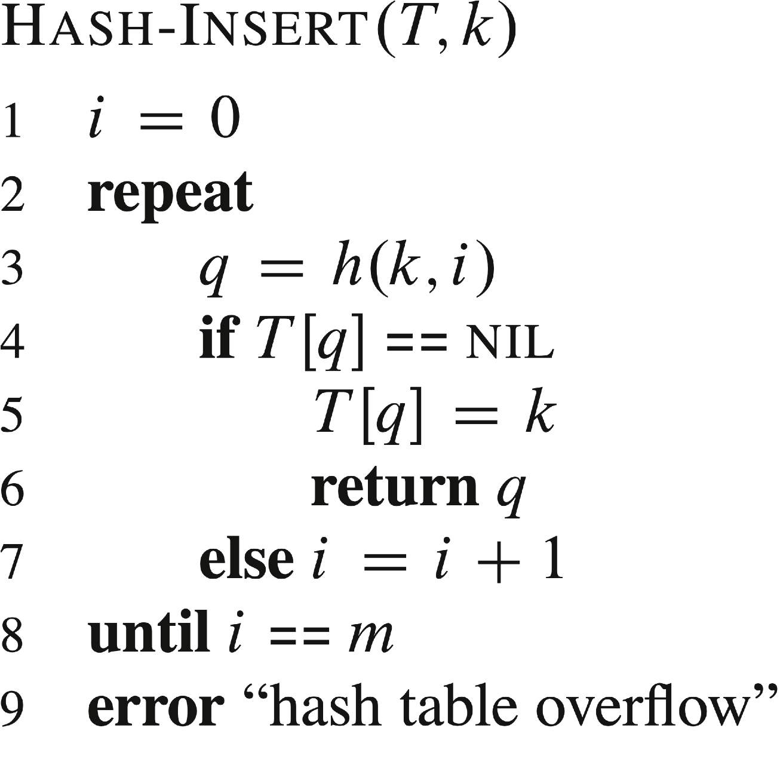
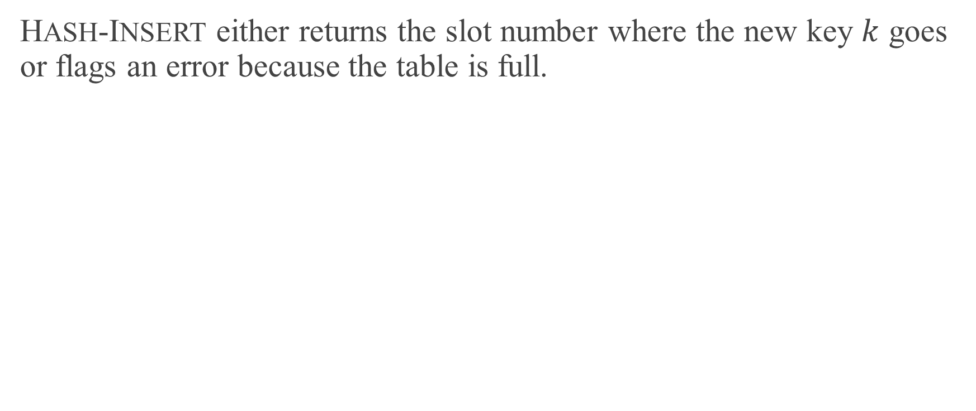
PSEUDOCODE FOR INSERTION
HASH-INSERT either returns the slot number where the new key $k$ goes or flags an error because the table is full.

Slide 32

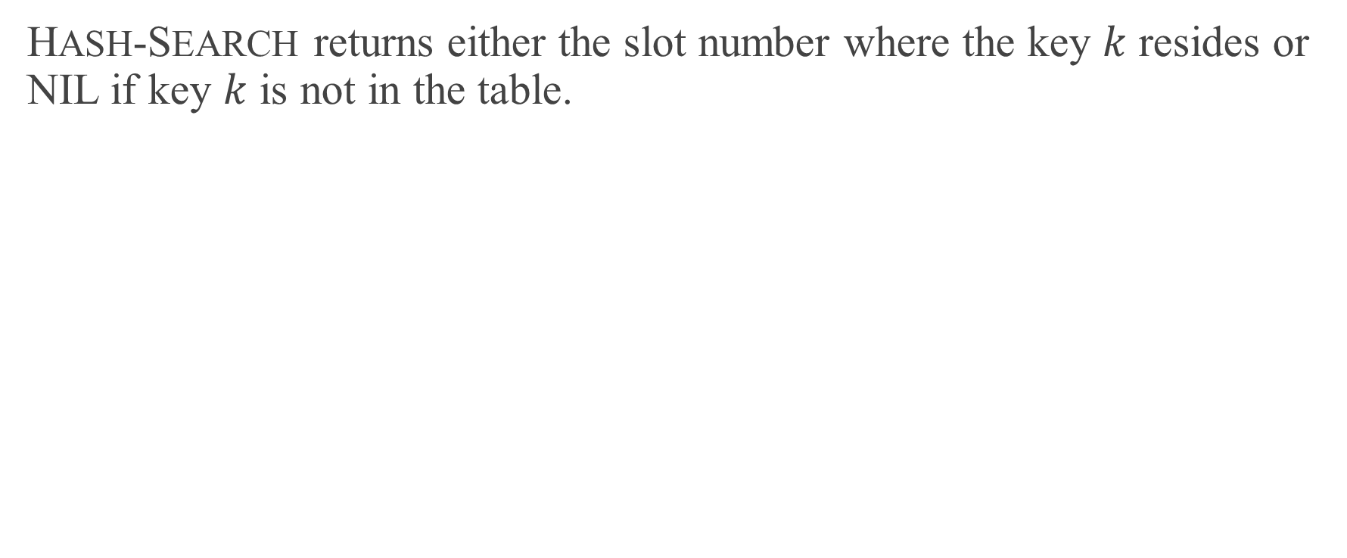
PSEUDOCODE FOR SEARCHING
HASH-SEARCH returns either the slot number where the key $k$ resides or NIL if key $k$ is not in the table.

Slide 33
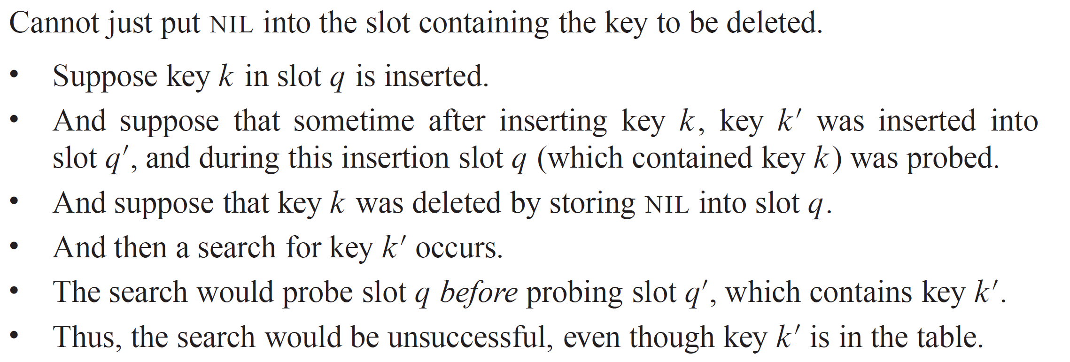
DELETION

Slide 34
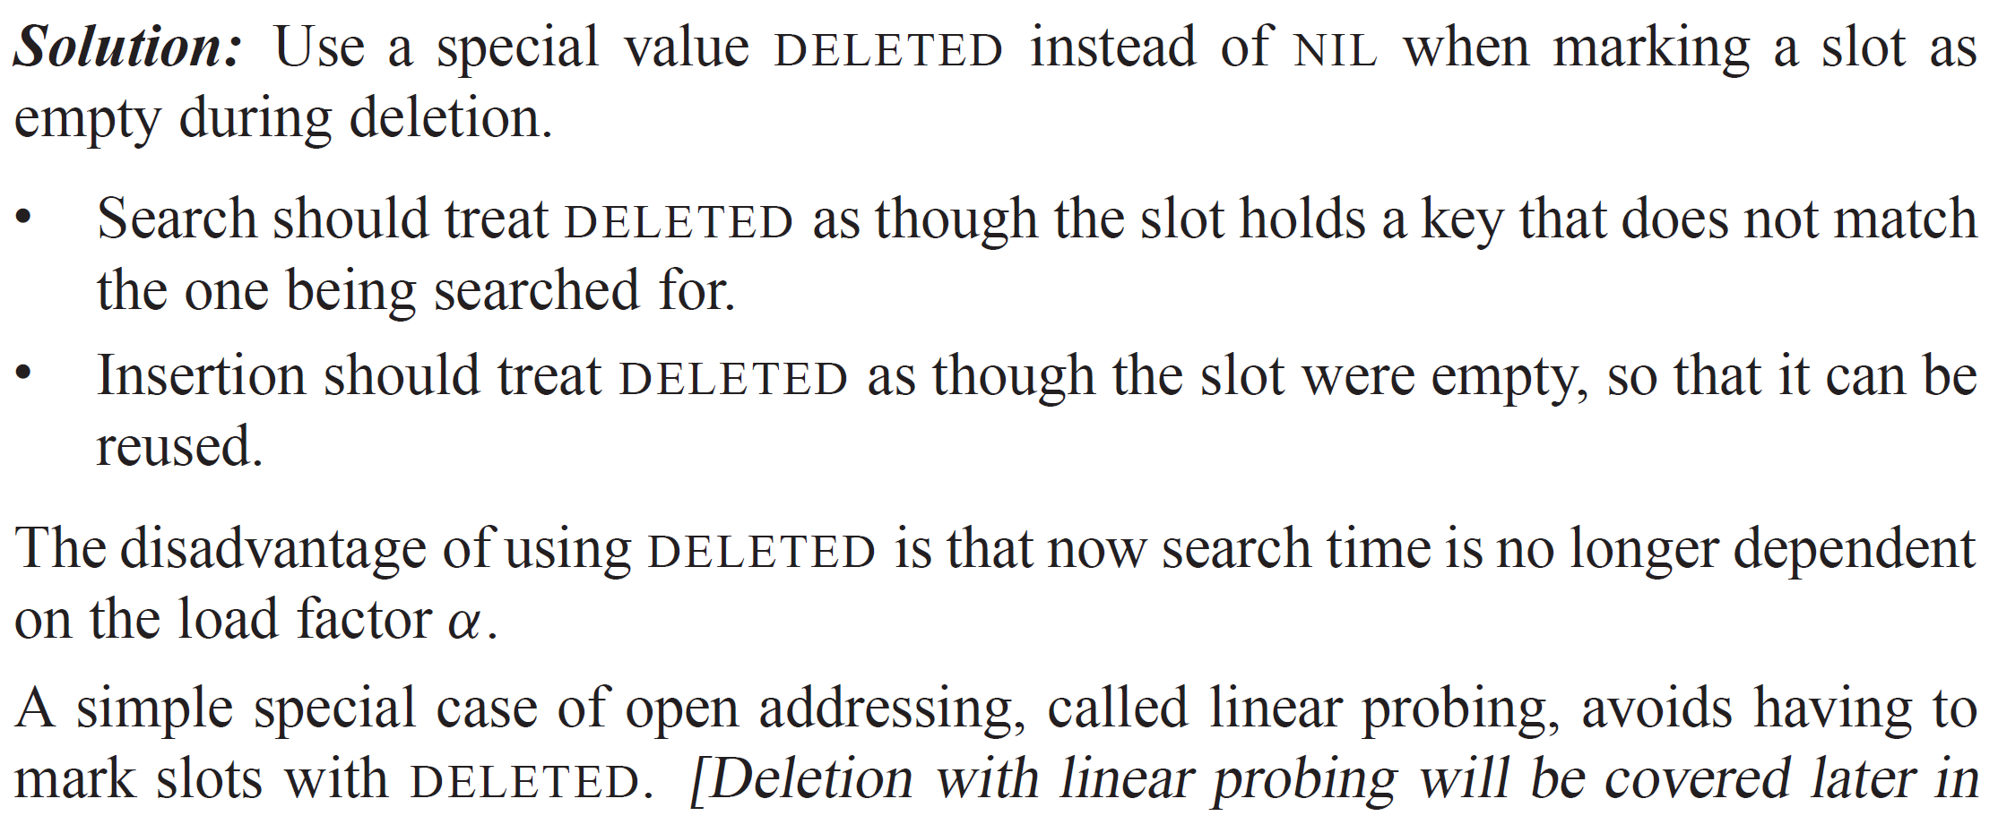
DELETION (continued)

Slide 35
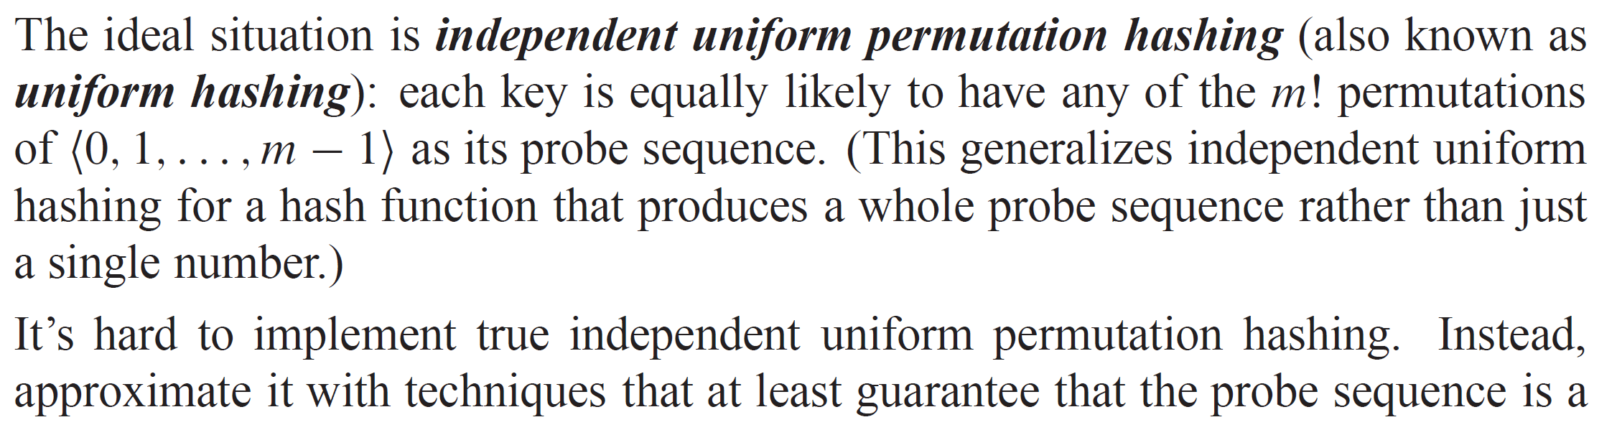
HOW TO COMPUTE PROBE SEQUENCES

Slide 36
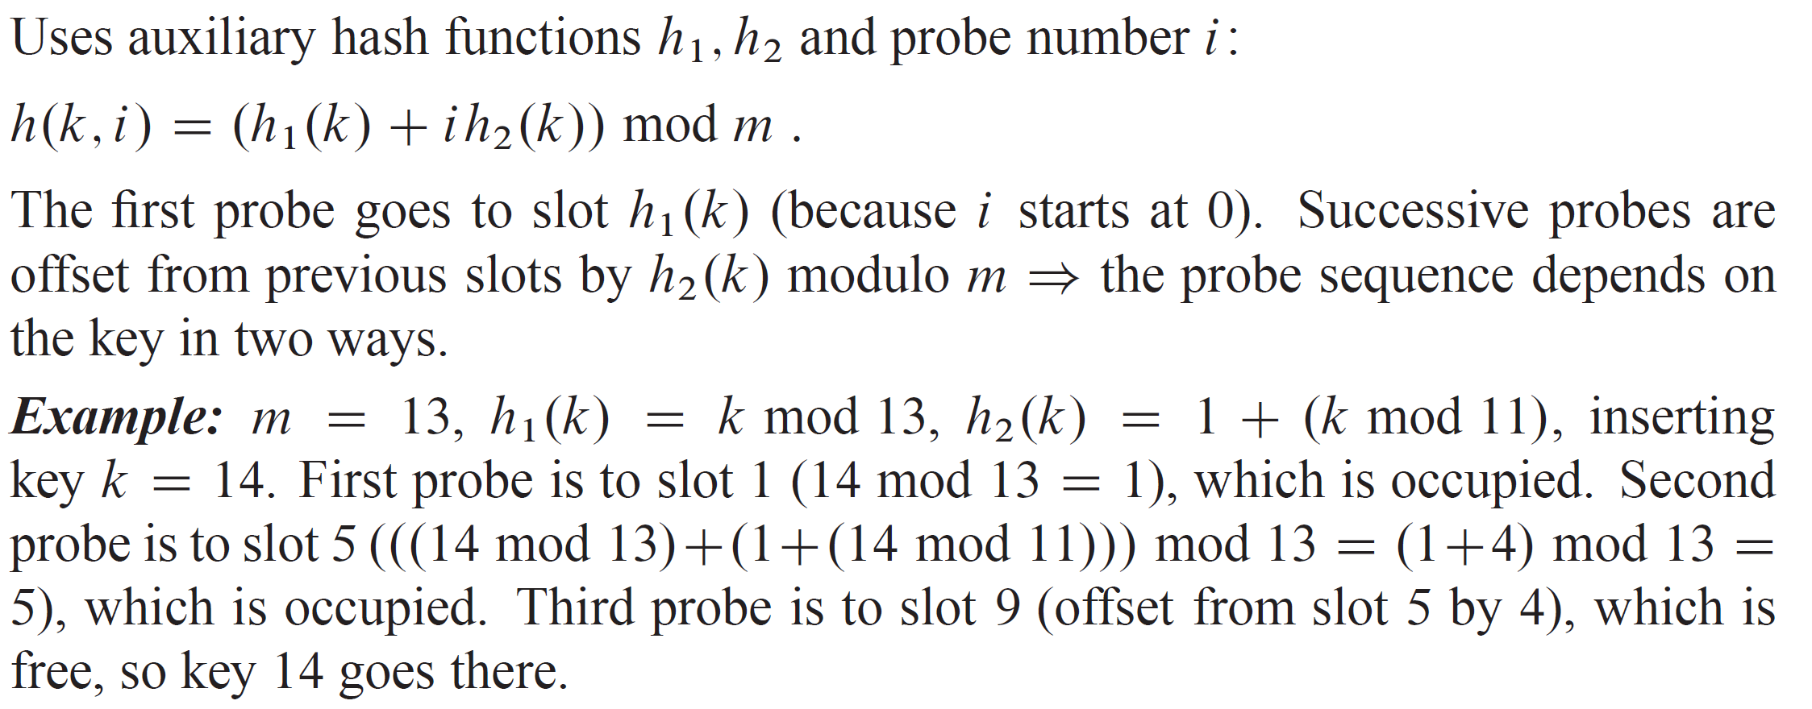
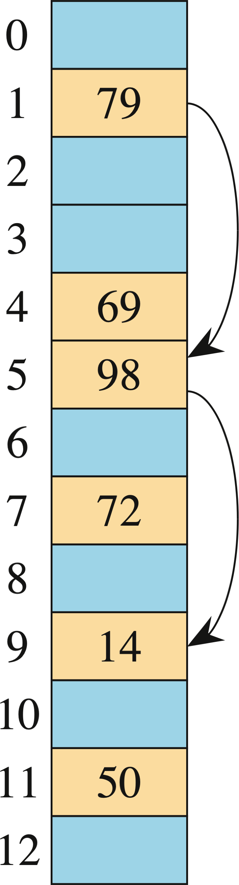
DOUBLE HASHING

Slide 37
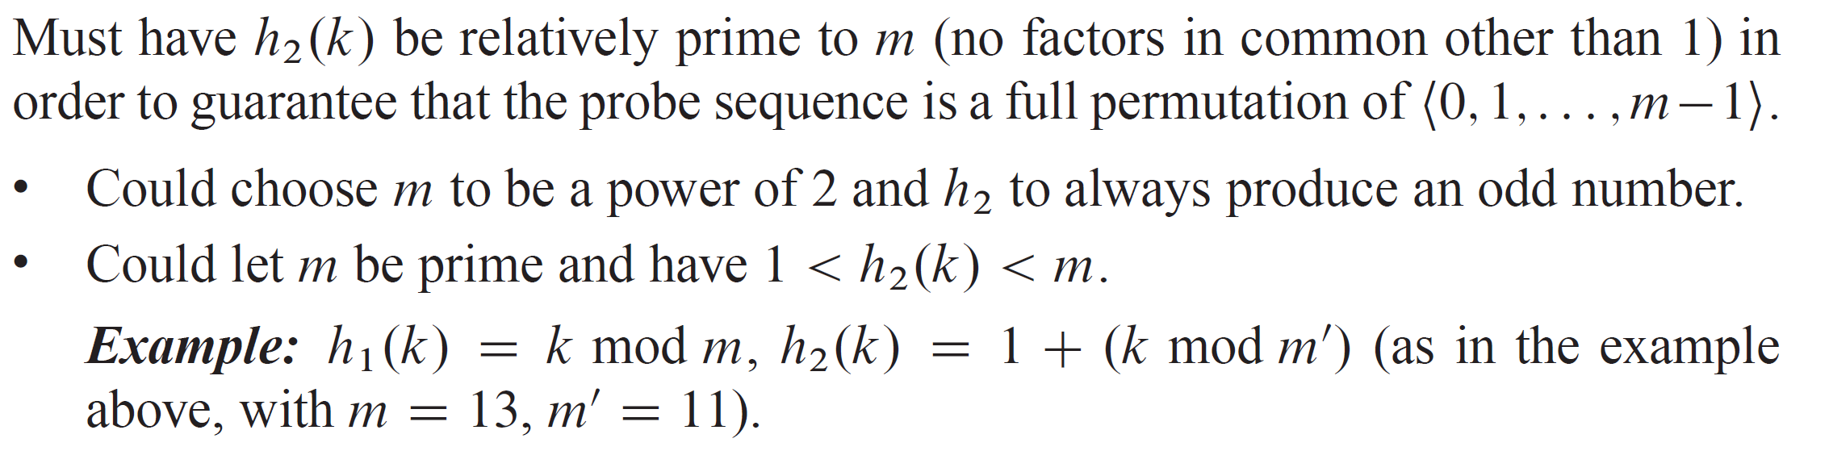
DOUBLE HASHING (continued)

Slide 38
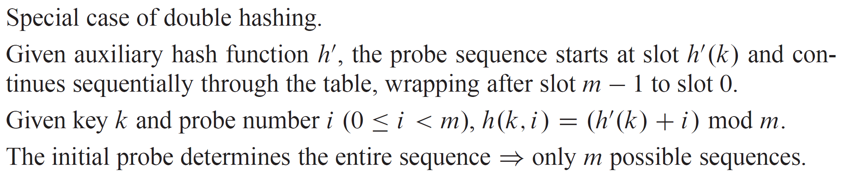
LINEAR PROBING

Slide 39
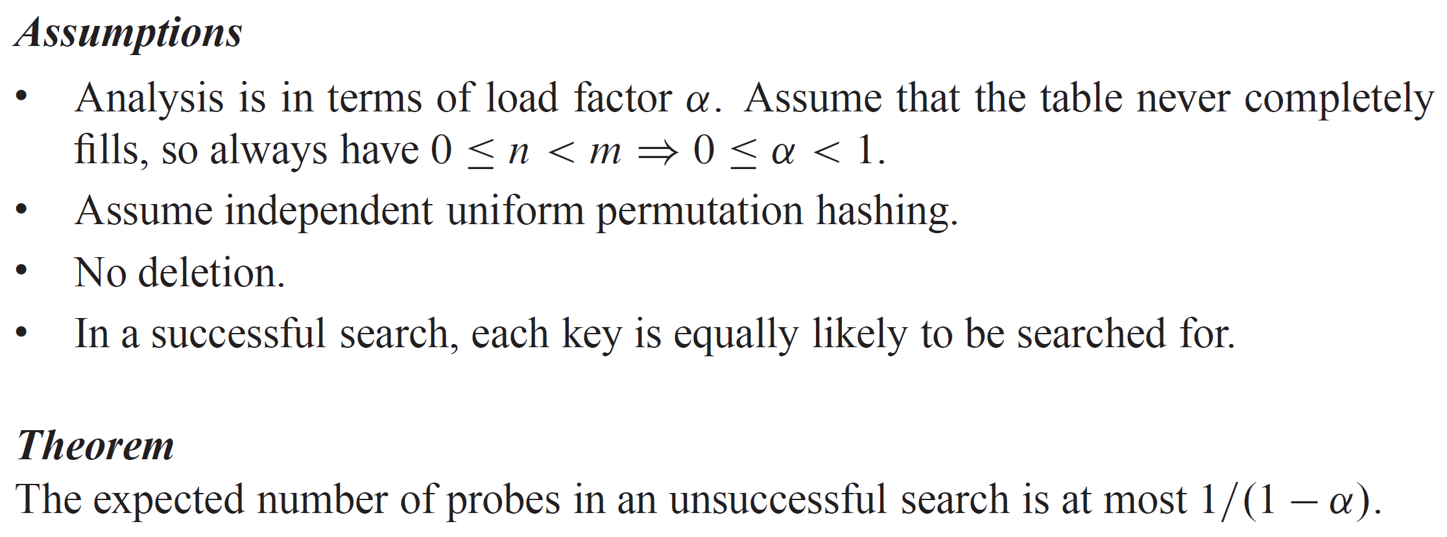
ANALYSIS OF OPEN-ADDRESS HASHING

Slide 40
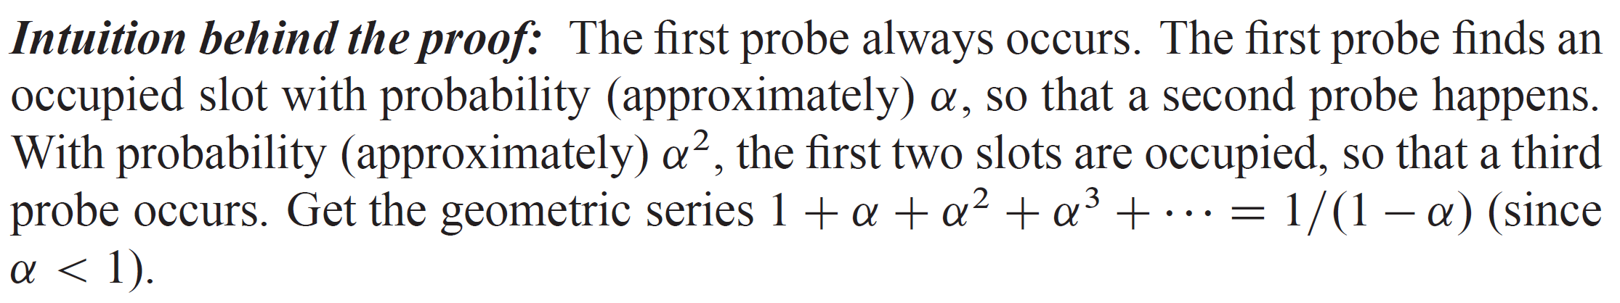
ANALYSIS OF OPEN-ADDRESS HASHING (continued)

Slide 41
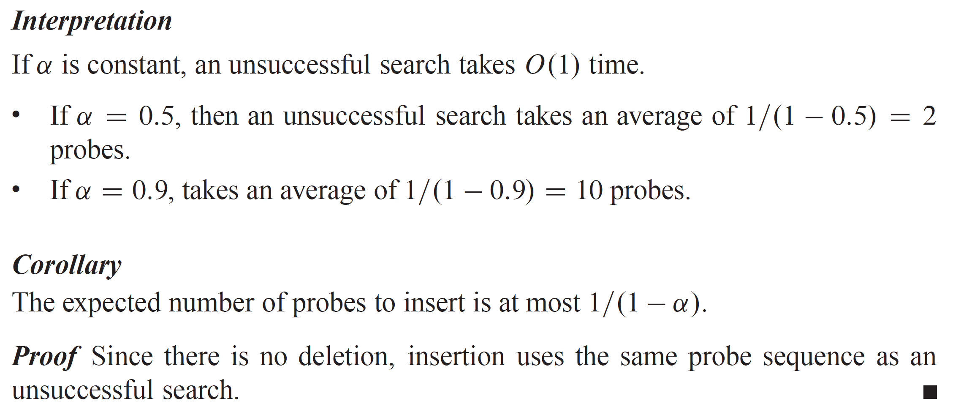
ANALYSIS OF OPEN-ADDRESS HASHING (continued)

Slide 42
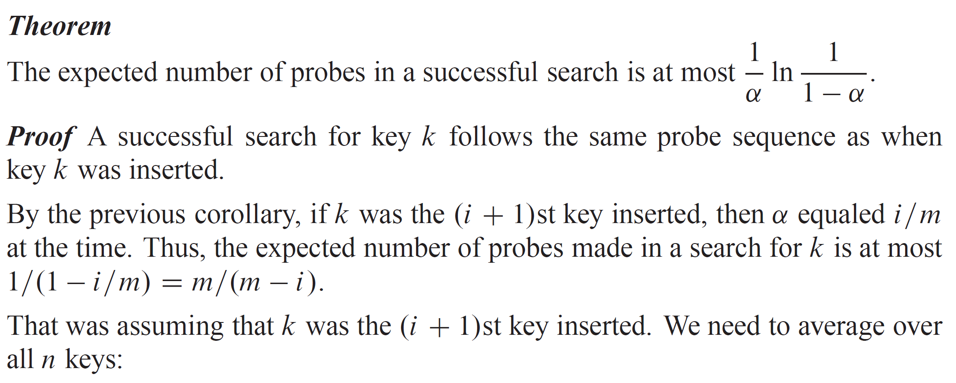
ANALYSIS OF OPEN-ADDRESS HASHING (continued)

Slide 43
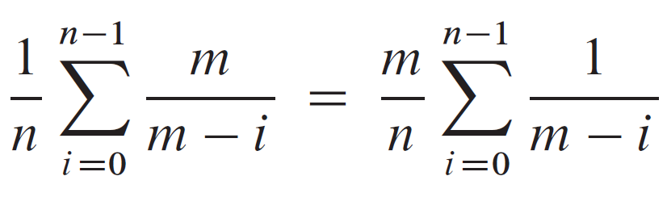
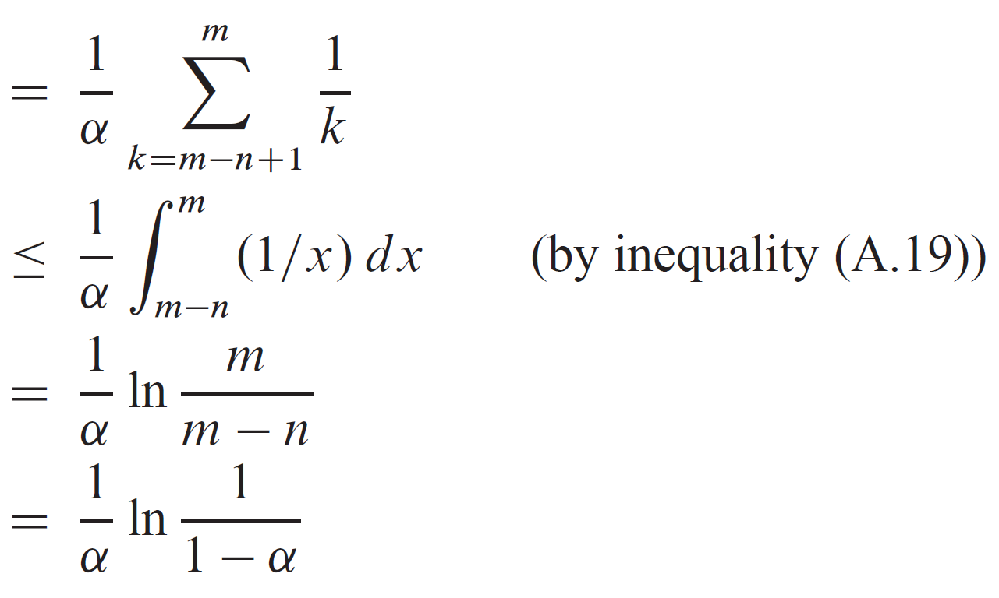
ANALYSIS OF OPEN-ADDRESS HASHING (continued)

Slide 44
PRACTICAL CONSIDERATIONS
Modern CPUs have features that affect hashing:
Memory hierarchies: Caches are small, fast memory units closer to where instructions execute. They are organized in cache lines of a specific size (e.g., 64 bytes) of contiguous bytes from main memory. It’s much faster to reuse a cache line than to fetch from main memory. Iterating through a cache line is relatively fast.
Advanced instruction sets: Advanced primitives for encryption and cryptography can also be used to compute hash functions.
Linear probing
Linear probing performs poorly in the standard RAM model, but it does well in the presence of hierarchical memory because successive probes are likely to be within the same cache line.
Notes:
The textbook covers an approach to allow deletion without using the DELETED marker.

Slide 45
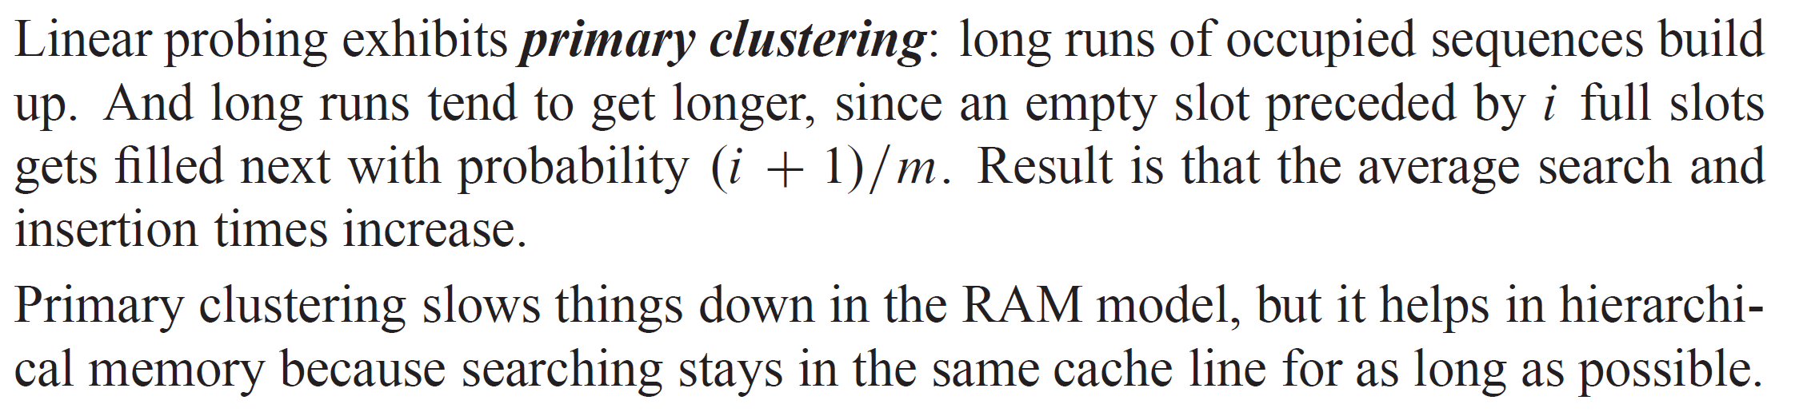
ANALYSIS OF LINEAR PROBING
Notes:
=

